Slide 1
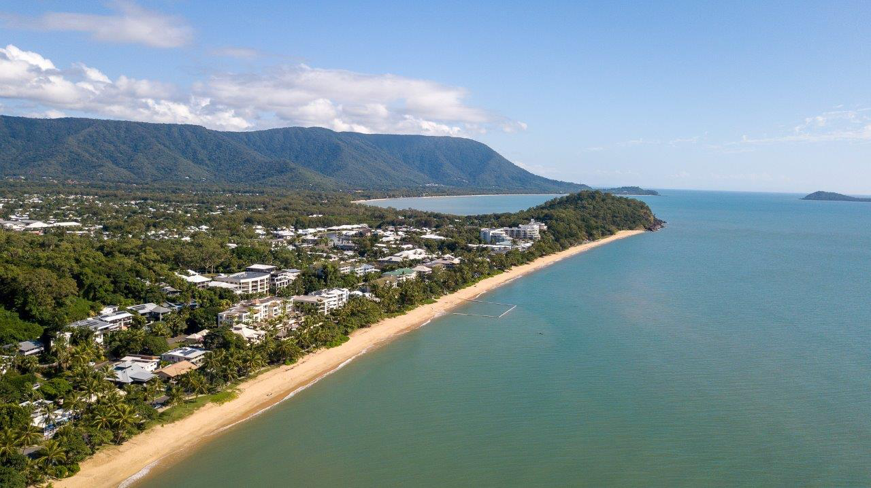
ACKNOWLEDGEMENT OF COUNTRY
I’d like to begin by acknowledging the Gimuy Walubara Yidinji and Yirrganydji people who are the traditional custodians of the land where I reside. I would also like to pay my respects to the Darkinjung people of NSW; your lands raised and moulded my passion for environmental sociology.

Slide 2
A critical discourse analysis of disaster resilience policy and plans of Local Government Areas in Tropical Queensland.
2
Research Question:
How do the Local Governments of Tropical Queensland use the term “disaster resilience” in their policy and plans?
Kallen Farley
Bachelor of Arts and Social Sciences (Honours)
Supervisor: Dr. Merrilyn Crichton
>

Slide 3
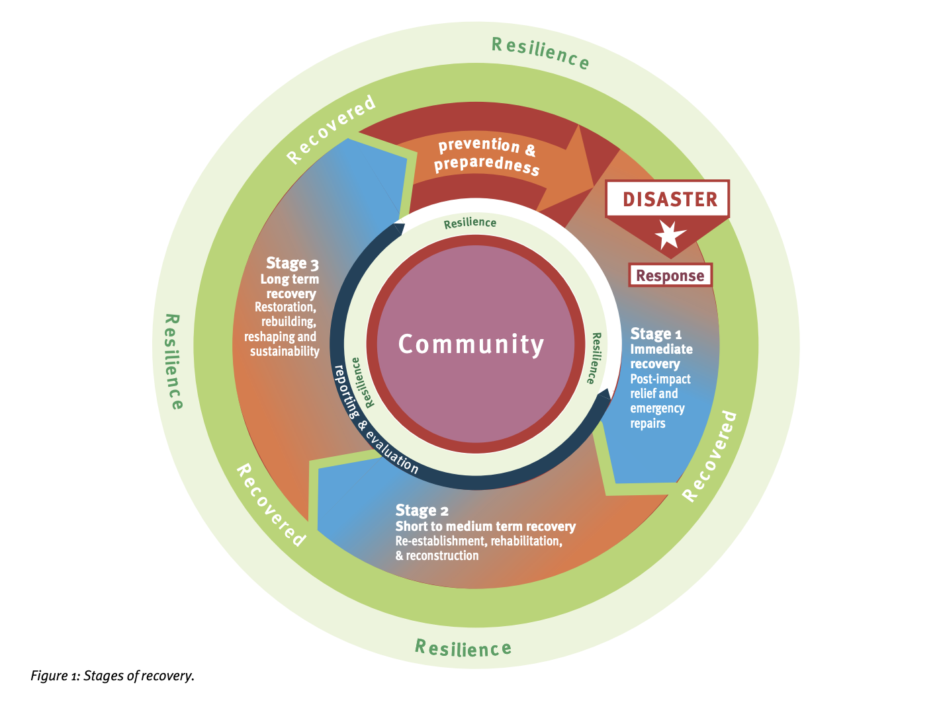
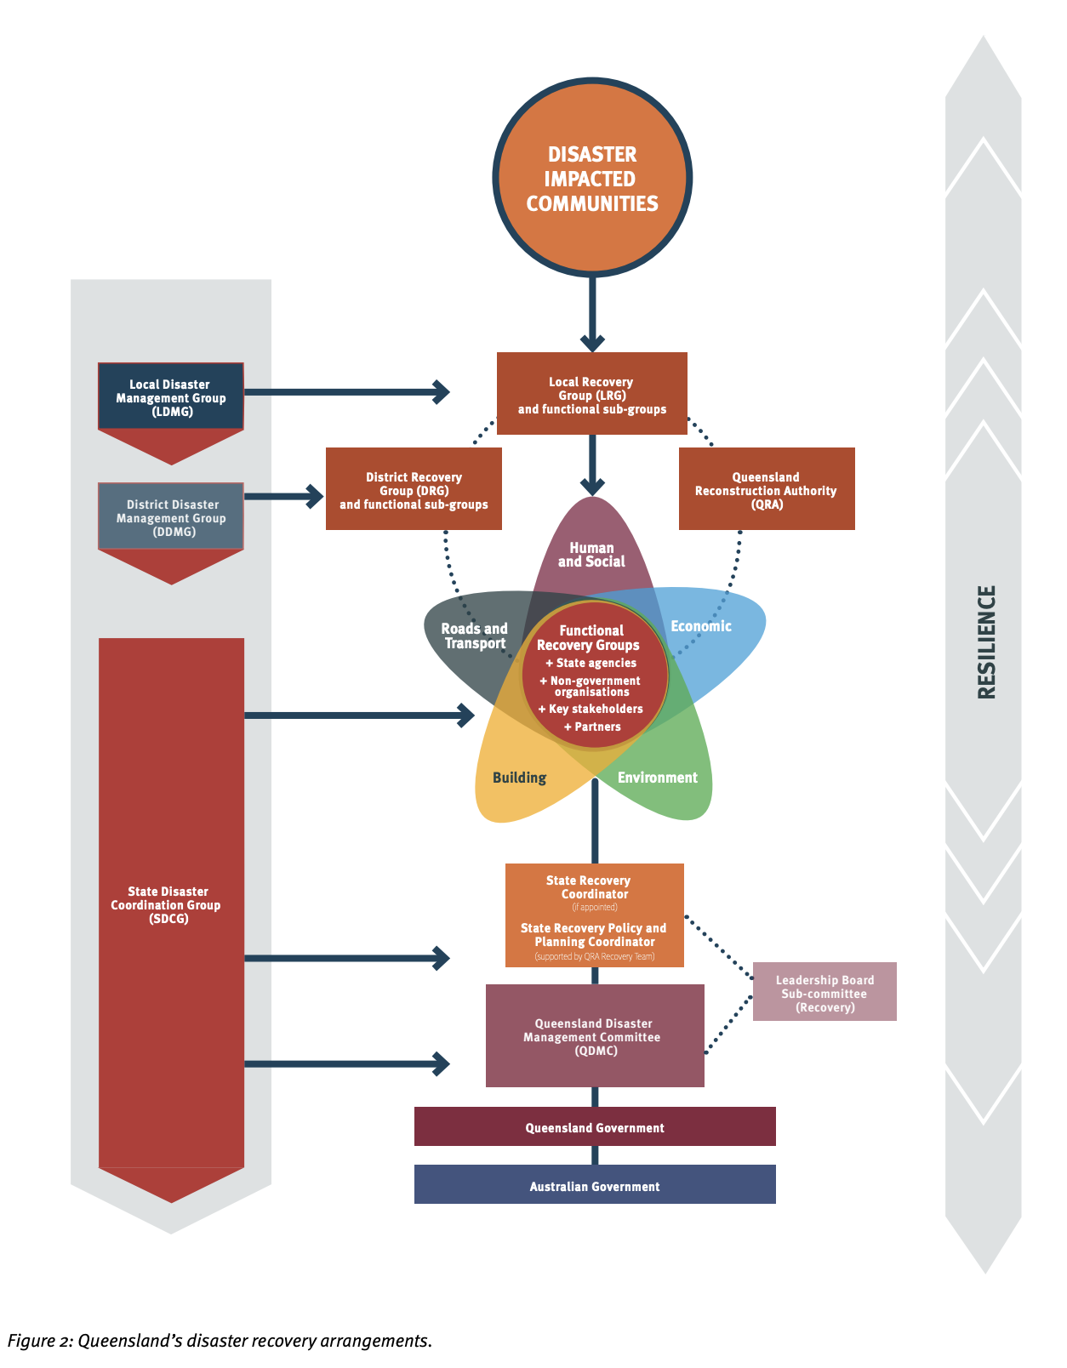
QUEENSLAND
RECOVERY PLAN (2023)

Slide 4
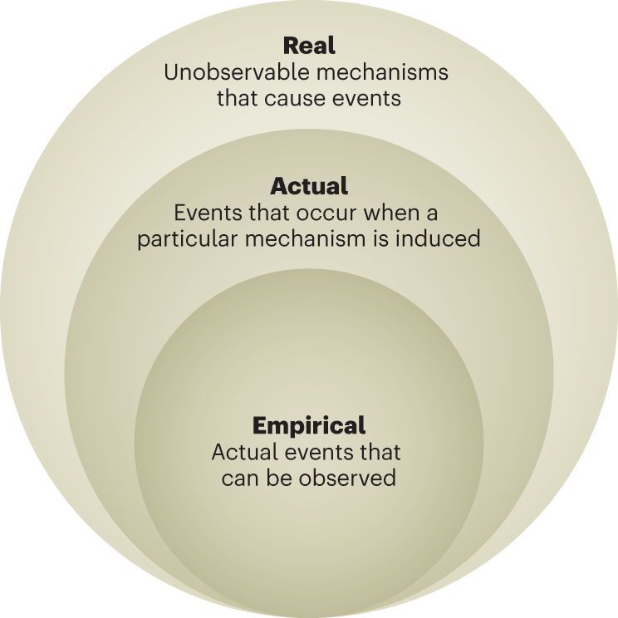
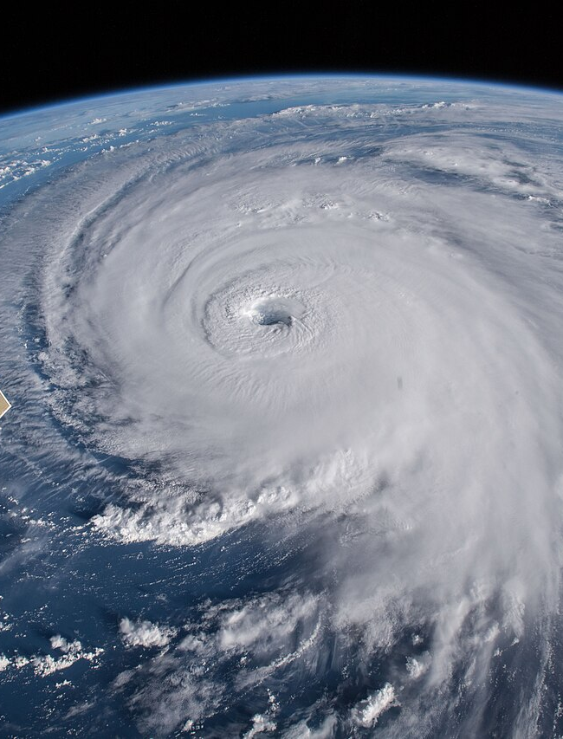
THEORETICAL LENS
Political ecology derives its ideas from the ontological perspective of critical realism, which emerges from the 'epistemic fallacy'. This is reducing what we say is 'real' or exists (ontology) to what we can know or understand about the 'real' (epistemology) (Bhaskar, 2020).
This is often why there is a distinction between the term “natural hazard”—which is the objective natural event that occurs—and “natural disaster” which concerns the losses associated with a hazard and extends primarily from inequalities in human society.

Slide 5
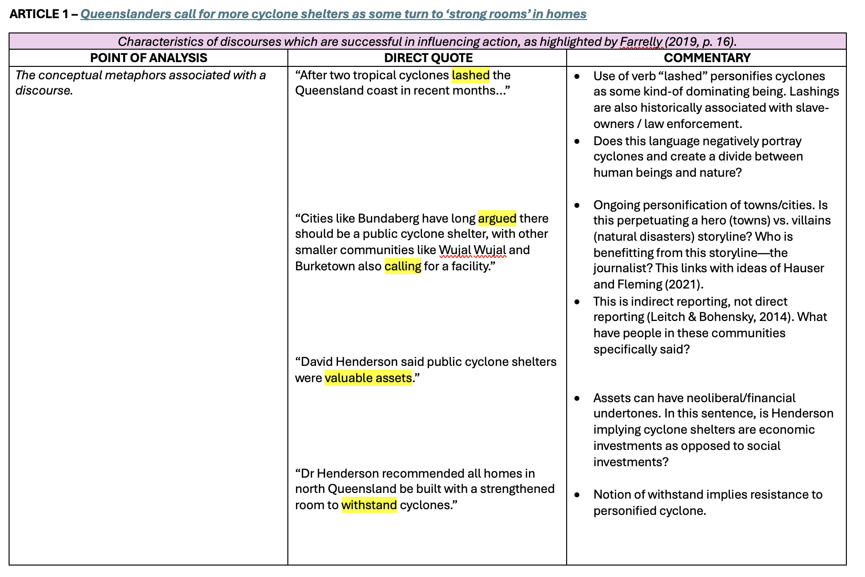
METHODOLOGY
Critical Discourse Analysis (CDA) is a qualitative research method that explores the ways in which social power, abuse, domination, and inequalities are enacted, reproduced, and resisted in text and talk across both social and political contexts (Benjaminsen & Svarstad, 2019).
I will be using a tabular format to conduct my discourse analysis. The left column depicts my point of analysis as described by my chosen scholar; the central column depicts quotes from the text that align with this point; and the third column acts as my running commentary supported by links to previous research.
The examples in this slideshow stem from a practice analysis I completed for ASH401 of media articles.

Slide 6
FARELLY (2019)
>
Characteristics of discourses which are successful in influencing action, as highlighted by Farrelly (2019, p. 16).
The conceptual metaphors associated with a discourse. The field in which the vocabulary of a discourse is primarily associated. The classification system implied. The system of values implied by a discourse.

Slide 7
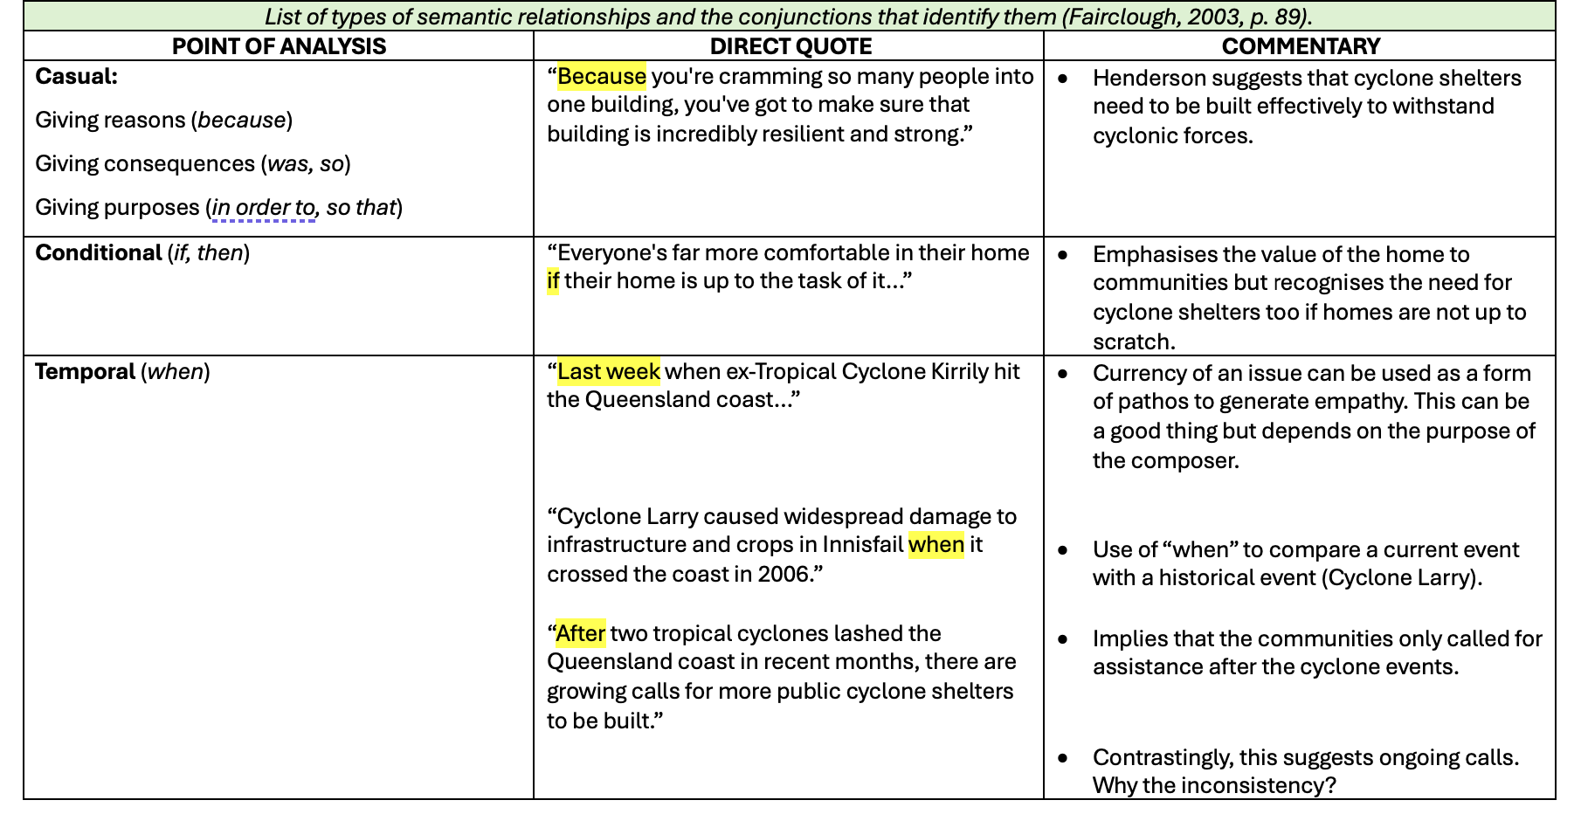
FAIRCLOUGH (2003)
List of types of semantic relationships and the conjunctions that identify them (Fairclough, 2003, p. 89).
Casual Giving reasons (because) Giving consequences (was, so) Giving purposes (in order to, so that) Conditional (if, then) Temporal (when) Additive (and) Elaborative (no conjunction, typically) Contrastive (but)

Slide 8
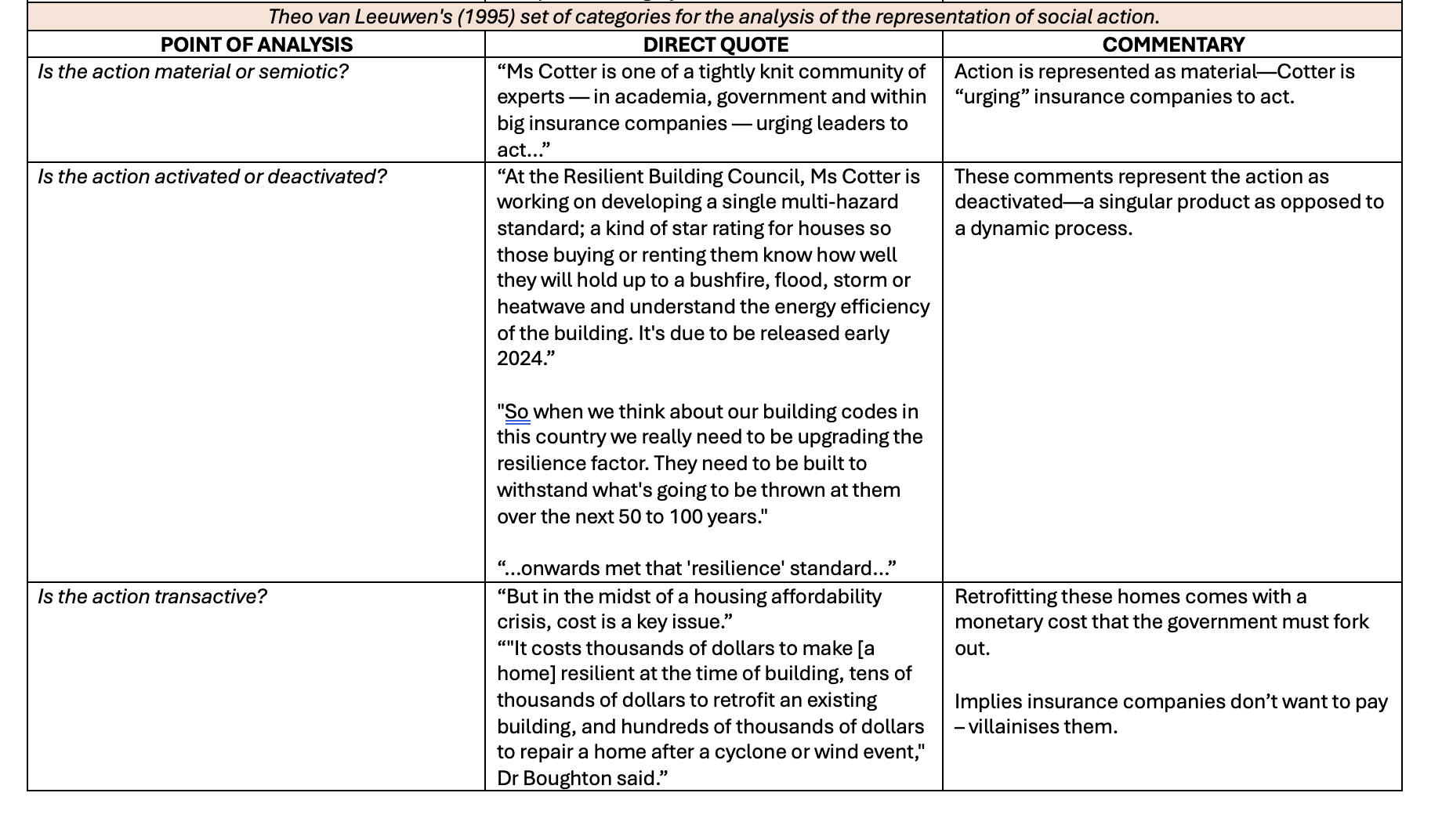
VAN LEEUWEN (1995)
Theo van Leeuwen's (1995) set of categories for the analysis of the representation of social action.
Is the action material or semiotic? Is the action activated or deactivated? Is the action transactive? Is the action instrumental? Is the action agentalised or deagentalised? Is the action abstracted or generalised?
>

Slide 9
PRELIMINARY FINDINGS
>
Resilience often acts as an “aspirational rhetorical device”.
The personification of natural disasters in policy as “villains” to perpetuate an “us vs. them” / “humanity vs. nature” storyline.
The voices of experts and government officials are prioritised over community expertise/experience.
And, finally, resilience is often tied to the concept of “mateship”.

Slide 10
A critical discourse analysis of disaster resilience policy and plans of Local Government Areas in Tropical Queensland.
10
Research Question:
How do the Local Governments of Tropical Queensland use the term “disaster resilience” in their policy and plans?
Kallen Farley
Bachelor of Arts and Social Sciences (Honours)
Supervisor: Dr. Merrilyn Crichton
>

