Slide 1


Importance of HDR for CSU’s research strategy
Notes:
This morning I’m pleased to provide an update on the implementation of our research strategy. We are tracking well against our agreed KPIs in research, and there has been a marked improvement in culture as it relates to research, with staff across the university understanding the importance of improving research performance to secure our university’s future, in particular being focussed on undertaking high quality research that has impact.
As noted in the cover, the portfolio is tracking favourable to budget, which has been achieved through some cost savings to offset the lower than budgeted research income ytd. The Gulbali Institute, an Institute established from our historical research strengths in agriculture and the environment, has been extremely successful in securing new grants. Despite significant efforts to secure new grants, grant capture has been slower than planned for both AICF and RHRI, which reflects that as relatively greenfield institutes for CSU it has taken time to recruit and onboard staff, implement support mechanisms, and then develop grant and other income opportunities. Despite this, as I hope will be demonstrated today, the pipeline of opportunities is strong.
Before we launch into deep dives for both AICF and RHRI, I’ll summarise our broader position in research.

Slide 2
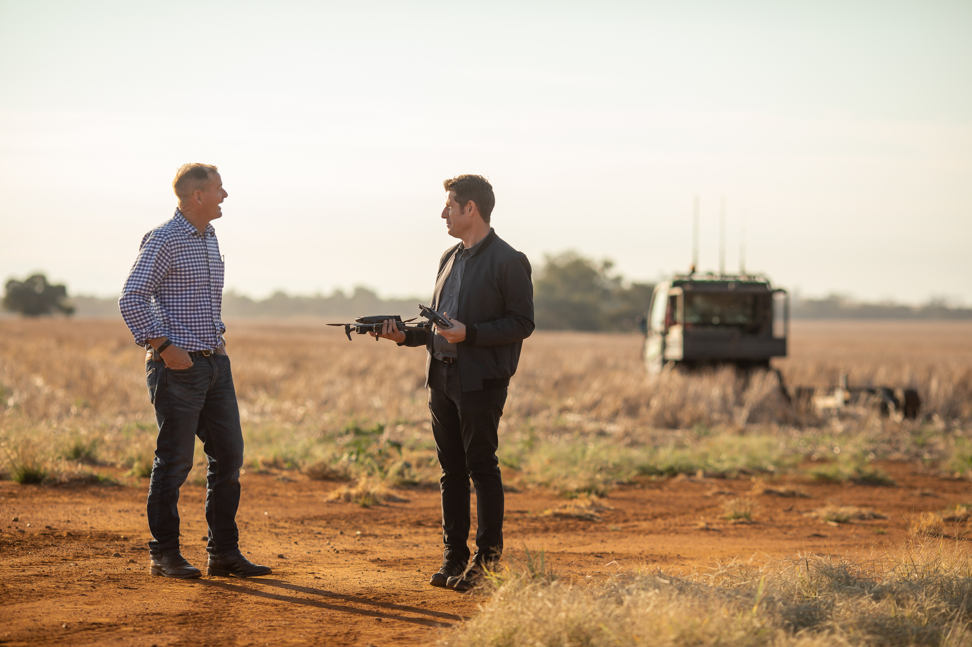
Research
Vision |
Charles Sturt’s vision is to be a sustainable world class, research-driven university for the study and practice of rural health, cyber, food and water security and regional wellbeing
Objective |
Grow our applied research in core focus areas through strong industry, government and regional partnerships, world class scholars, excellence in research support services, and digital expertise.
The imperatives that will guide us to the 2030 vision are:
Building World Class Research Institutes
Supporting and Delivering Excellence in Research
Establishing Enduring Partnerships for Societal and Commercial Impact
Developing Next Generation Leading Scholars and Researchers
Notes:
Our vision remains to be a sustainable and world-class university, driven by research, with a focus on addressing challenges in rural health, cyber, food and water security and regional wellbeing. We will achieve our vision through growing our applied research through strong partnerships, recruiting world class staff, and excellence in supporting our research.
Our World class institutes are now established, and we are progressing well against our imperatives of supporting and delivering research excellence, establishing enduring partnerships, and developing the next generation of leading researchers.

Slide 4



KPI Performance: on track
LEVEL 1 KPIs
LEVEL 2 KPIs
Research Quality
Target: 4 Fields of Education at/over ERA 3 (2024)
Actual: No actual results as ERA 2024 (or its replacement) is not yet announced; however, Level 2 KPIs indicating research quality are tracking well
Net Research Contribution
Research Performance Metrics
Actual: August YTD $2.2m favourable to budget target
Actual September YTD:
Field-Weighted Citation Impact 2.18 v 1.65 target
Q1/Q2 Journals 91% v 93% target
Scholarly Output 911 v 1,300 full year target
Research Income
Target: Total Research Income $51m (2024)
Actual: YTD August $27m v $33m budget, with 45% growth on 2023
Academic Staff with PhDs
Actual: YTD Q2 78.4% v 73% target
World University Rankings
Actual: QS world ranking 851-900 v 801-1000 target
THE rankings will be published on 9 October, verbal update will be provided at the Council meeting
HERDC Income
Actual: August YTD $17.4m on track to achieve full year target of $23.3m
Notes:
We’re well on track to meeting our research KPIs for 2024. As we saw on the previous slide, our assessment based on indicators of research quality, gives us some confidence that had an ERA exercise been undertaken recently, we would have met the world standard research threshold in 4/8 of our FoE. In terms of research income, August YTD was around $6m behind budget, but with the large pipeline of grants we expect to make up some if not all of this deficit by year’s end. It is noteworthy that income is 45% greater than at the same time last year.
For level 2 KPIs, as mentioned in my introduction, net research contribution is favourable to budget. We are currently well ahead on both the % of academic staff with PhDs and FWCI, and marginally behind for the percentage of publications in Q1/2 journals. We are well on track to exceed the yearly targets for HERDC income and total scholarly output.
For global rankings, we achieved our KPI for QS World rankings, remaining in the 800-1000 band, while in the recently released THE WUR, we achieved our target of remaining in the 800-1000 band, in fact we were very close to entering the 600-800 band, and were one of only a handful of Australian universities to improve our ranking, which was driven predominately by a marked improvement in the indicators relating to research environment and research quality

Slide 5

THANK YOU

Slide 6
Progress towards the Australian University Provider Category Standards:
Making progress
* ERA 2023 estimate based on Field-Weighted Citation Impact trends
Field of Education | Institute Investment | Targeted Investment | ERA 2018 | ERA 2023 estimate* | Ranking estimate
01 Natural and Physical Sciences | RHRI, Gulbali | Yes | 3 | 3 | World standard
02 Information Technology | AICF | Yes | 3 | 3 | World standard
03 Engineering |  | Very limited | N/A | N/A | Not assessed by ERA, insufficient output
05 Agriculture and Environment | Gulbali | Yes | 4 | 5 | Well above world standard
06 Health | RHRI | Yes | 2 | 2-3 | World standard with some risk
07 Education |  | Limited | 3 | 3 | World standard
08 Management and Commerce |  | Very Limited | 2 | 2 | Below world standard
09 Society and Culture |  | Very limited | 2-3 | 2-3 | On the cusp of world standard
10 Creative Arts |  | No | 2 | N/A (no longer offering courses) | N/A
Notes:
The research requirements to meet Australian University PCS mean that we must demonstrate that we are undertaking research at or above world standard in at least 50% of the broad Fields of Education that we offer courses in. In the 2018 ERA exercise, which occurred before the new PCS came in, this table shows that we were undertaking research at or above world standard in 4/9 FoE, i.e. below the 50% requirement. Of course this data is significantly lagged, for example publications relate to a 6 year period prior to the exercise. The planned ERA 2023 exercise was cancelled by the minister, but we ran an internal evaluation based on metrics such as FWCI, to gauge where we would have landed had the exercise progressed. This showed that we would have still been at world standard or better in 4 broad FoE, and that there had been some improvement in a further 2 FoE, but we could not be confident that we would have met world standard in these. Given we not longer teach in the creative arts FoE, we think we would have met the 50% threshold with 4/8 FoE having research at world standard or better. We used this analysis in our submission for reaccreditation to TEQSA, which they accepted, but they want to see us continuing to monitor this, hence the importance of this discussion today.

