Slide 1
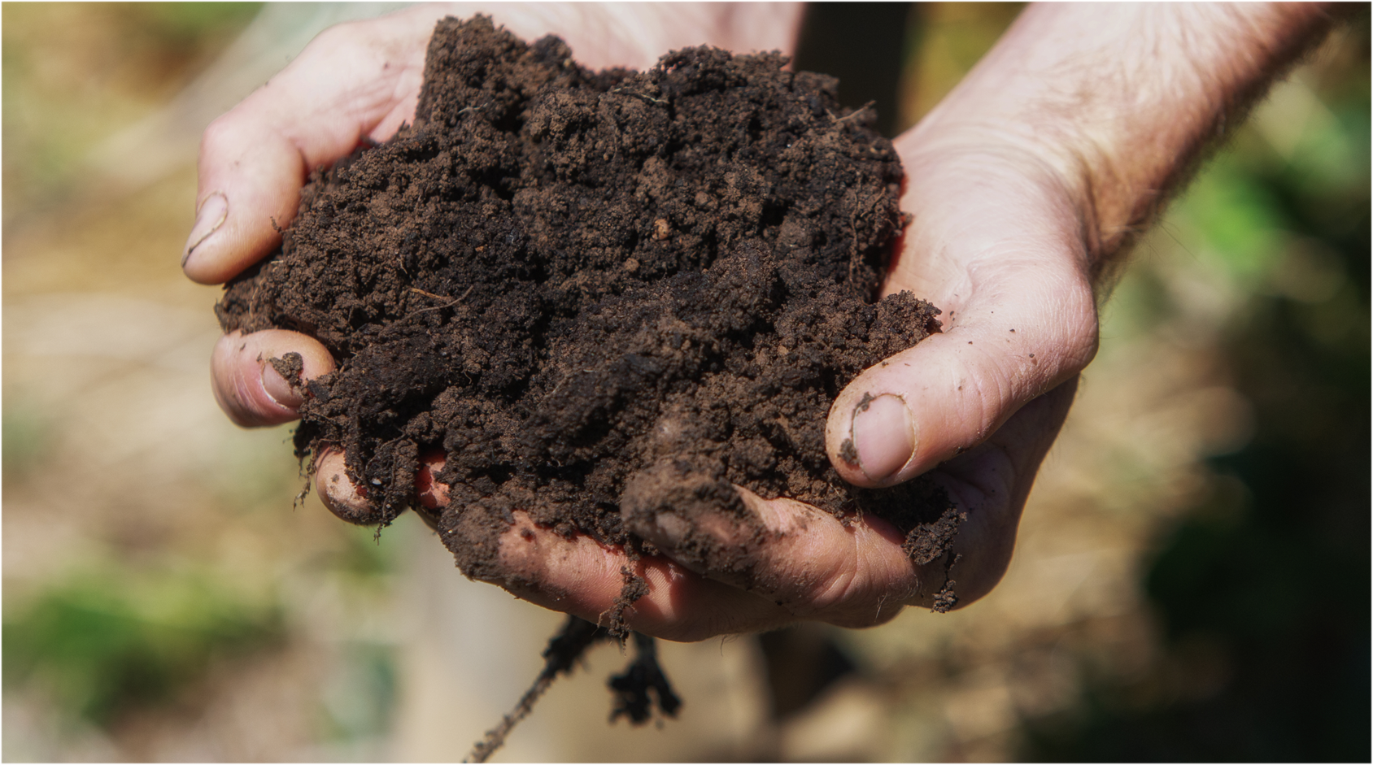
Section Three
Agriculture and changes to biomes: Soil loss and degradation
Notes:
Og designed slide

Slide 2
Soil, agriculture, and land degradation
Soils differ between biomes BUT
agriculture has also changed the nature of soils in the biomes in which it operates.
In some areas, this has led to land degradation, or the loss of soil health and integrity through processes such as
  erosion
  salinity
  acidity
  compaction
  loss of fertility

Slide 3
What is arable land?
We need arable land to grow our food
[class works together to define arable land]

Slide 4

Arable land in an apple
Watch Matt Evans demonstrate the amount of arable land worldwide.
  How does Matt define arable land?
  How much land is arable?
  How much arable land is abandoned due to topsoil loss every five seconds?

Slide 5
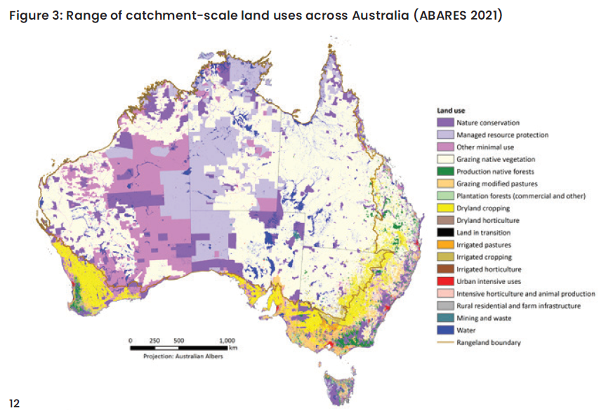
Arable land in Australia
Source: National Soil Strategy DAWE 2021, National Soil Strategy, Department of Agriculture, Water and the Environment, Canberra, April. CC BY 4.0. ISBN 978-1-76003-395-8.

Slide 6
Intensive agriculture and land degradation in Australia
What does the assessment of soil in different land use zones show?
Case Study: Vegetation cover as a national indicator of soil health and erosion riskexploring

Slide 7
Land use and soil degradation
According to the Australian government’s State of the Environment Report, soils can be changed or degraded by various processes including:
  changes to native vegetation caused by fire, clearing, grazing, and cultivation, leading to salination and erosion
  intensive use of inputs such as artificial fertiliser, herbicides and pesticides
  intensive use of practices such as irrigation, tillage, heavy machinery – these can degrade soil through acidification, topsoil loss (erosion), nutrient imbalance, compaction, reduced biological activity and organic carbon loss
In vulnerable dryland regions, human-induced soil degradation is an important contributing factor in desertification, defined as a persistent or irreversible reduction in the capacity of ecosystems to supply ecosystem services for decades

Slide 8
How are farmers responding
Australian farmers are moving away from practices that degrade soils and adopting practices that help to restore soil health.
Agriculture accounts for over half of Australia’s land use so the sustainable management of this land is an important issue for both farm businesses and the general public. There are many sustainable land practices that have become standard for Australian farmers. For example:
  many broadacre cropping farms retain stubble (85% of farms), minimise tillage (68% of farms) and optimise the use of (and reduce reliance on) pesticides or fertiliser (65% of farms)
  many livestock farms are using a variety of grazing management systems such as cell, trip or rotational grazing (61% of farms) and setting a long-term groundcover requirement (61% of farms).
(Source https://www.agriculture.gov.au/abares/products/insights/snapshot-of-australian-agriculture)

Slide 9
The sustainable land management toolkit

Slide 10
The outcomes of soil stewardship

Slide 11
Key Takeaway
Not all soil degradation is permanent.
Farmers can use soil management strategies that can restore soil health over time.

Slide 12
Class activity
What are the soil stewardship practices mentioned in the article?
What are the benefits to the farmer of using these practices?
What are the benefits to the soil mentioned in the article?
What are the benefits to the wider community/environment mentioned in the article?
Can you think of any other benefits not mentioned in the article?
Article: New ways worth exploring

Slide 13
Agricultural practices, wind erosion and dust storms
Wind erosion is a natural process that moves soil from one location to another by wind power. It can cause significant economic and environmental damage.
Wind erosion can be caused by a light wind that rolls soil particles along the surface through to a strong wind that lifts a large volume of soil particles into the air to create dust storms.
While wind erosion is most common in deserts and coastal sand dunes and beaches, certain land conditions will cause wind erosion in agricultural areas.
So, it is wind that drives the erosion, but it’s mainly the landscape and condition of the land which leads to the most damaging wind erosion
(https://www.environment.nsw.gov.au/topics/land-and-soil/soil-degradation/wind-erosion)

Slide 14
Biomes, land use and dust storms
Describe the relationship between biomes (grasslands and shrublands). Some forms of land use (cropping and grazing) can contribute to dust storms in grasslands and shrublands
Dust storms lead to loss of fertile topsoil on farms and also create economic and health problems for people in cities and towns.
The immediate causes of dust storms are climate-related – dust storms occur when there is dry weather or drought combined with wind.
Dust storms are more likely to occur in grasslands or shrublands. These biomes are typically flat, meaning that the wind is not naturally slowed down.
Native vegetation (including deep-rooting grasses and native shrubs) helps hold the fragile topsoil together and creates wind breaks. It creates natural protection against dust storms.
Agricultural practices that change native vegetation can make these biomes more vulnerable. Clearing native vegetation (shrubs and small trees); deep ploughing and leaving ground bare between crops all make wind erosion more likely.

Slide 15
Class discussion
What biomes are most vulnerable to damaging wind erosion (dust storms)?
What are the primary natural causes of wind erosion?
How do agricultural practices make dust storms more likely?
What practices are farmers using to minimise the risk of dust storms?
Article: Dust storms could be around the corner, how science can help us prepare

