Slide 1
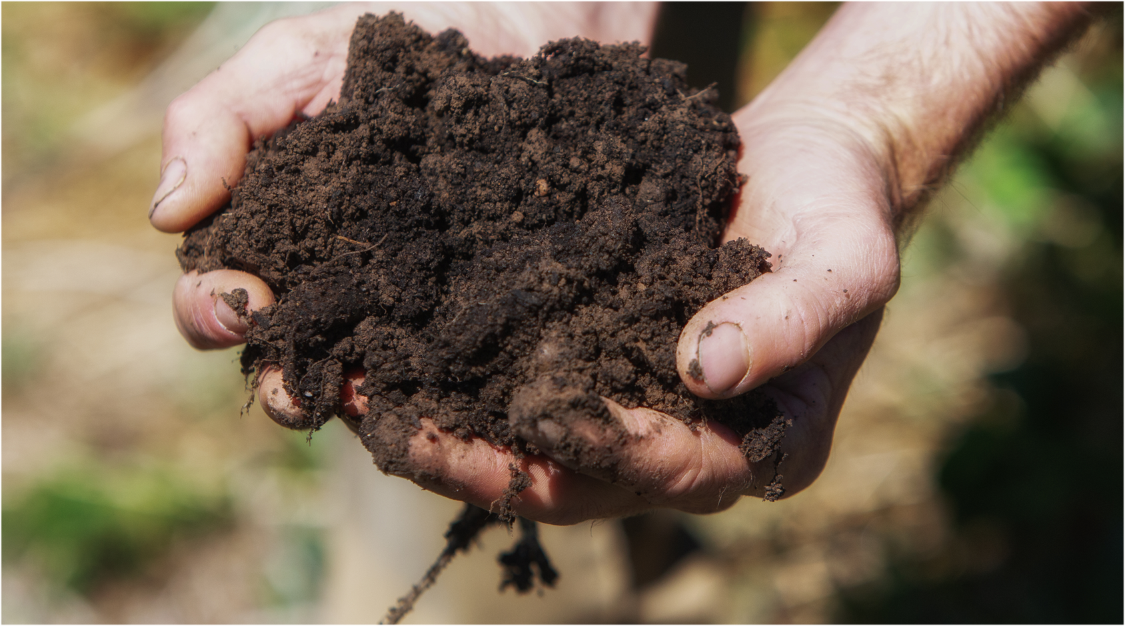
Section One
Soil and our food
Notes:
Og designed slide

Slide 2
Where does our food come from?
98% of our food comes from the soil

Slide 3
Spaghetti bolognaise
PASTA is made of WHEAT which grows in SOIL
BEEF MINCE comes from COWS which eat GRASS OR GRAIN which grow in SOIL
CHEESE is made of MILK which comes from COWS which feed on GRASS which grows in SOIL
ONIONS grow in SOIL
TOMATOES grow in SOIL or can be grown hydroponically (without soil)
MUSHROOMS grow in COMPOST which is made of COW MANURE and STRAW.
COW MANURE COMES from COWS which eat GRASS which grows in SOIL and STRAW grows in SOIL

Slide 4
What could we eat if there was no soil?
[ask the class for their ideas]

Slide 5
Sushi
SEAWEED grows in the OCEAN
RICE grows in SOIL
SALMON comes from the OCEAN / SALMON is raised in FISH FARMS where it is fed CORN and SOY, POULTRY MEAL, and FISH MEAL. CORN and SOY grow in SOIL. POULTRY MEAL comes from CHICKENS which eat CORN and SOY which grows in SOIL. FISH MEAL comes from FISH which come from the ocean
MAYONAISSE comes from EGGS and OIL. EGGS come from CHICKENS which eat CORN and SOY which are grown in SOIL. OIL comes from CANOLA (or nuts, seeds or olives) which grows in SOIL

Slide 6
Extension activity
Our oceans as a source of food
  Today, more than a billion people worldwide rely on food from the ocean as their primary source of protein. Approximately 20 percent of the world’s population derives at least one-fifth of its animal protein intake from fish. Many jobs and economies in the United States and around the world depend on the fish and shellfish that live in the ocean. Decreasing [fish and shellfish] harvests could especially hurt the poorest people and the least developed nations that have the fewest agricultural alternatives. These challenges may influence migration to more urban regions, which may lead to further social disruption and even conflict. (Source: National Oceanic and Atmospheric Administration, U.S. Department of Commerce)

Slide 7
Questions
What are the main threats to global fish stocks? How long will global fish stocks last if we do nothing?
Can we have healthy oceans if we do not look after our soils?

