Slide 1
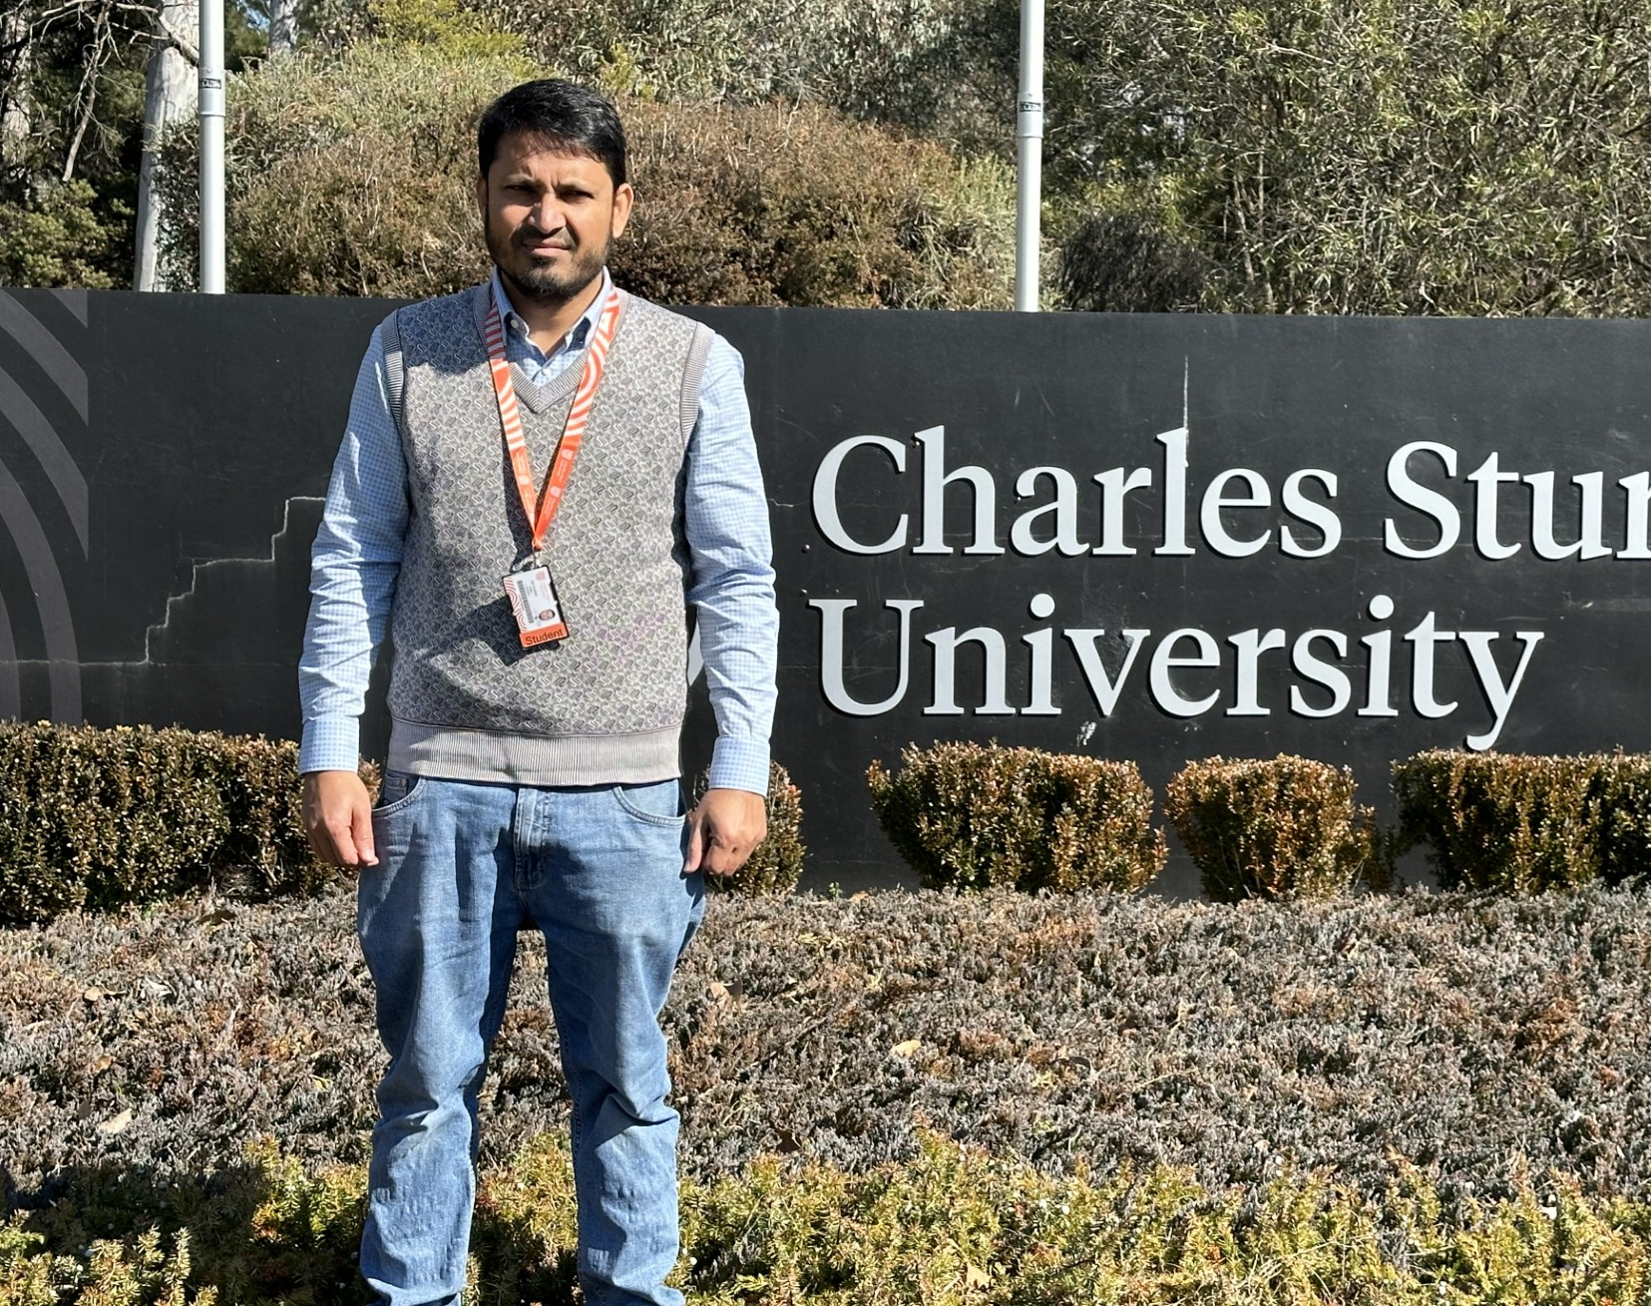
Information Journeys for CALD Older Australians when accessing Home Care Services
Md Shofiqul Islam
mdsislam@csu.edu.au
School of Information and Communication Studies
Faculty of Arts and Education

Slide 2
Acknowledgement of Country
As members of the Charles Sturt community we acknowledge the words of the Wiradjuri people, on whose land our university was founded, and share their aspiration of Yindyamarra Winhanga-nha, the aim for us all to learn the wisdom of respectfully living well, in a land worth living in.
We pay our respect to the traditional custodians of the lands on which Charles Sturt campuses are located, the Wiradjuri, Ngunawal, Gudungarra and Biripai people of Australia and pay respects to their elders, past, present and emerging.

Slide 3
Background
Information journey is understanding of how individuals seek, process, and use of information in different context.
It is a continuum of activities of information
judgments,
processing,
utilisation, and
dissemination.

Slide 4
Background
Information journeys in diverse groups:
health and academia (3-stage model),
patients of healthcare, journalism and law (4-stage model),
practice of marketing professionals (5-stage model),
experience of Chinese older migrants (5-stage model) and
higher education (5-stage model) (Adams & Blandford, 2005; Blandford & Attfield, 2010; Du, 2014, 2023; Gibson & Smith, 2018).

Slide 5
Background
Information journeys in diverse groups:
In health academia: (i) initiation of information needs, (ii) facilitation or gathering of information, and (iii) interpretation of acquired information (Adams and Blandford, 2005, p.160).
In patients of healthcare, journalism, and law: (i) recognising an information need, (ii) acquiring information, (iii) interpreting, and often validating, that information, and (iv) using the interpretation (Blandford & Attfield, 2010, p.30)
In marketing professionals: (i) recognition of information needs related to work tasks, (ii) information seeking, (iii) evaluation of acquired information and judgement, (iv) making sense of and using the obtained information and (v) sharing the obtained or assembled information (Du, 2014, p.1850).

Slide 6
Background
Information journeys in diverse groups:
For older Chinese migrants: (i) information seeking pertaining to migration, (ii) identification of primary concerns of living, (iii) orientation within new and local information landscapes, (iv) response to the new information reality, and (v) reconstruction of information landscapes during transitional phases of understanding, negotiation, and resolution (Du, 2023, p.1).
For higher education: (i) find and gather information, (ii) filter, (iii) process and shape, (iv) create, and (v) share (Gibson & Smith, 2018, p.739).

Slide 7
Background
In June 2020, around 4.2 million (16%) (AIHW, 2023).
1.2 million CALD represent over one-third (37%) (AIHW, 2023).
Aged care services and average length of service received:
Home care packages (HCP) & 17 months
Residential care (respite and permanent) & 21 days and 22 months
Transition care & 12 weeks (Khadka et al., 2019, AIHW, 2024; Department of Health and Aged Care, 2024)
Courtesy: National Institutes of Health

Slide 8
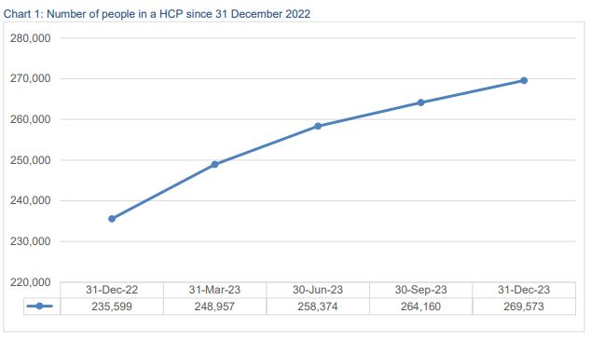
Background
HCP older adults
2017 | 2022 | 2023
69,500 | 235,599 | 269,573
Out of 269,573 HCP, 89,657 in NSW (Department of Health and Aged Care, 2024).
In June 2015, 26% of all home care recipients were older CALD Australians (Department of Health, 2019).
HCP workforces are also growing (Pereira et al., 2022).

Slide 9
Background
 | Bangladeshi |  |  | Indian |  |  | Chinese
 | In Australia |  | 65⁺ Year at NSW n | In Australia |  | 65⁺ Year at NSW n | In Australia |  | 65⁺ Year at NSW n
Census Year | Total N | 65⁺ Year n (%) |  | Total N | 65⁺ Year n (%) |  | Total N | 65⁺ Year n (%)
2011 | 27808 | 276 (0.99) | 144 | 295362 | 20673 (6.99) | 6345 | 318969* | 31653 (9.92) | 18810
2016 | 41233 | 664 (1.61) | 362 | 455388 | 28483 (6.25) | 8913 | 509557* | 46844 (9.19) | 27393
2021 | 51491 | 1849 (3.59) | 1040 | 673352 | 42294 (6.28) | 13786 | 549618* | 76228 (13.87) | 42560
*Excluding special administrative regions (SARs) and Taiwan

Slide 10
Problem statement
CALD older adults
often experience a sense of isolation from their broader community (Georgeou et al., 2023).
faced more significant challenges in obtaining social and healthcare support than their Anglo-Australians counterparts (Du, 2023).
life quality is impacted due to their lack of English language skills (Orb, 2002)
found to encounter noteworthy hindrances when accessing information (Baker et al., 2016; Du, 2023).

Slide 11
Research aim, objectives and questions
Aim
to explore the information journeys of CALD older adults who are currently accessing HCP and their carers’ perspective to support ageing well in Australia.
Objectives
to explore the information behaviours, information seeking sources, and patterns of meaning making among CALD older adults as they access HCP;
to identify the need for enhancing associated information services for CALD older adults;
to investigate the adoption of HCP and the support received from formal and informal carers by CALD older adults to support ageing well in Australia

Slide 12
Research aim, objectives and questions
Research questions
1. What are the information journeys of CALD older adults while accessing HCP in the migrated country?
2. How do CALD older adults perceive and comprehend the seeking, validation and interpretation of information to enhance their ageing well while pursuing HCP?
3. What interventions can be implemented to better support CALD older adults in accessing HCP and supporting ageing well in Australia?
4. How do formal and informal carers support CALD older adults in adopting home care to promote ageing well in Australia?

Slide 13
Methodology
CEIB framework is an innovative approach to study human-information interactions.
The CEIB methodological framework consists of five core principles:
starts with community
prioritising collaboration
focusing on usefulness
using appropriate and diverse methods and
affirms reciprocity (Du & Chu, 2022, p.6).
This study will be guided by the CEIB principles.

Slide 14
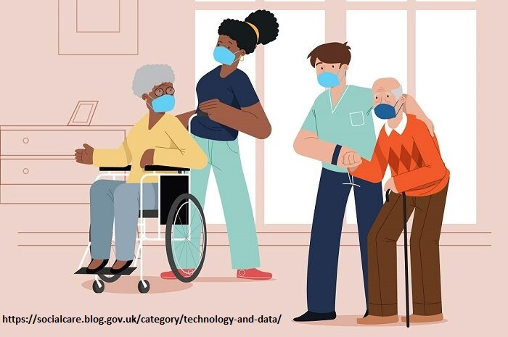
Methodology
Study site, sampling and screening
NSW – Metropolitan and regional areas
42 samples ( 30 CALD older adults and 12 caregivers)
CALD Older Adults
Currently living in NSW
Citizen or permanent resident in Australia
Migrated from Bangladesh, India or China
Currently receiving a home care package from a registered service provider
Aged 65 or above
Interested in participating in an interview to talk about experiences of accessing and using home care packages
Confident in reading and speaking in either English or Bangla

Slide 15
Methodology
Caregivers
Currently living in NSW
Caring for an older adult (aged 65+) who has migrated from Bangladesh, India or China, either as a home care service provider or as a family member
Aged 18 years or older
Interested in participating in an interview to talk about caregiving role and support of people’s access to home care packages
Confident in reading and speaking in either English or Bangla
Ethical Application under review by CSU HREC

Slide 16
Methodology
Data Analysis
1. Verbatim transcription
2. Read, review, and explore
3. Determine preliminary insights
4. Prioritise relevant sections
5. Create narrative categories
6. An information journey model
Interview data will be coded using the NVivo software.

Slide 17
Research significance and expected contributions
Novel study
Develop a model detailing the information journeys
Introduce the perspectives of CLAD older adults on home care.
Offer substantial, evidence-based guidance on how information journeys can enhance the well-being, self-sufficiency, and social integration of CALD older adults.
The outcomes not only shed light on the specific challenges faced by selected groups in Australia but also identify innovative ways in which relevant information can effectively lessen these challenges in home care.
Envisaged to present the findings to the local councils and ethnic associations.
The outcome will aid policymakers and community leaders in better addressing the future needs of CALD older adults within home care services.

Slide 18
Acknowledgement
Principal Supervisor:
Professor Tina Du
Head of School, School of Information and Communication Studies
Co-supervisors:
Dr Waseem Afzal
Course Director and Senior Lecturer in Information Studies and
Prof. Raelene Wilding
Head of Department, Department of Social Inquiry, La Trobe University

Slide 19
References
Adams, A., & Blandford, A. (2005). Digital libraries' support for the user's' information journey'. Proceedings of the 5th ACM/IEEE-CS joint conference on Digital Libraries.
Baker, A. E., Procter, N. G., & Ferguson, M. S. (2016). Engaging with culturally and linguistically diverse communities to reduce the impact of depression and anxiety: a narrative review. Health & Social Care in the Community, 24(4), 386-398.
Blandford, A., & Attfield, S. (2010). Interacting with information. Springer Nature.
Du, J. T. (2014). The information journey of marketing professionals: Incorporating work task‐driven information seeking, information judgments, information use, and information sharing. Journal of the Association for Information Science and Technology, 65(9), 1850-1869.
Du, J. T. (2023). Understanding the information journeys of late-life migrants to inform support design: Information seeking driven by a major life transition. Information Processing & Management, 60(2), 103172.
Georgeou, N., Schismenos, S., Wali, N., Mackay, K., & Moraitakis, E. (2023). A scoping review of aging experiences among culturally and linguistically diverse people in Australia: Toward better aging policy and cultural well-being for migrant and refugee adults. The Gerontologist, 63(1), 182-199.
Gibson, P. F., & Smith, S. (2018). Digital literacies: Preparing pupils and students for their information journey in the twenty-first century. Information and Learning Science, 119(12), 733-742.

Slide 20
Questions & Comments

