Slide 1
Support to Researchers at CSU from Quantitative Consulting Unit (QCU)
Office of Research Services and Graduate Studies
6/11/2024 Copyright © Charles Sturt University 2020

Slide 2
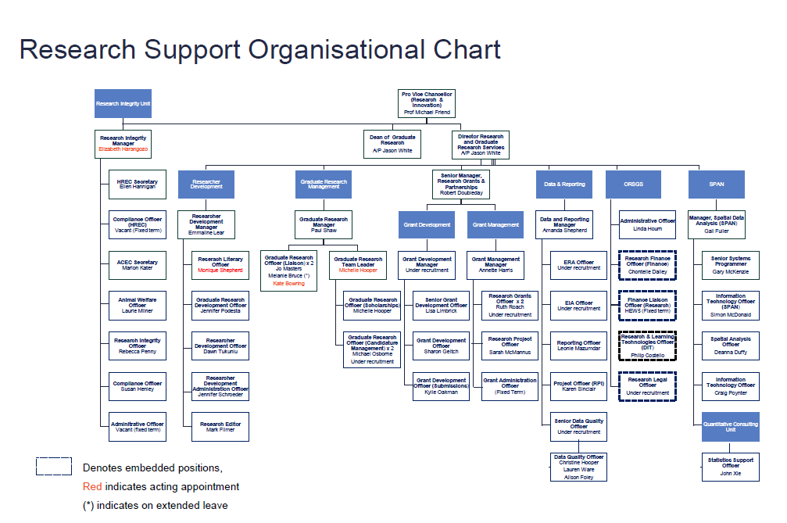
QCU in the Research Support Organisational Chart (2022):
Acting Manager:
Emmaline Lear
6/11/2024 Copyright © Charles Sturt University 2020

Slide 3
QCU’s core services include:
General consultancy on statistical theory and application related to research problems
Advice on, support to, and completion of statistical analysis needed from research projects
Tutorials/training for learning and using analysis software such as R, SPSS, G*Power3.1, Netica, and Winsteps.
Workshops for HDR students and researchers to enhance their statistical skills in special topics such as statistical power analysis, statistical analysis using R, Bayesian Networks, and IRT/Rasch models.
6/11/2024 Copyright © Charles Sturt University 2020

Slide 4
QCU’ service policy (effective 1st September 2017)
QCU provides a free (30-minute session) initial consultation service which may lead to
1. Further paid consultation services - $150 per hour (if necessary an extra free (30-min.) consultation session is available for further confirming the terms and conditions of the consulting services) or
(So far less than 5% of the cases are of this type)
6/11/2024 Copyright © Charles Sturt University 2020

Slide 5
QCU’ service policy (effective 1st September 2017)
2. Further free collaboration services (subject to an upper limit of the service hours allocated for each case) requiring co-authorship/ownership of research publications/outcomes if the contribution of the consultation service is substantial
A time limit (per case) available for the free services will be as follows:
10 hours for honours and masters students;
20 hours for doctoral candidate students;
20 hours for staff members.
Service priority will be applied in the order of:
Masters by research and Doctoral students (first priority);
Staff members (second priority); and
Masters by course and Honours students (third priority).
Any consultation time which exceeds the limit may be charged at $75 per hour unless an exemption is granted by the Office of Research Services and Graduate Studies (subject to the availability of QCU’s consulting resources).
6/11/2024 Copyright © Charles Sturt University 2020

Slide 6
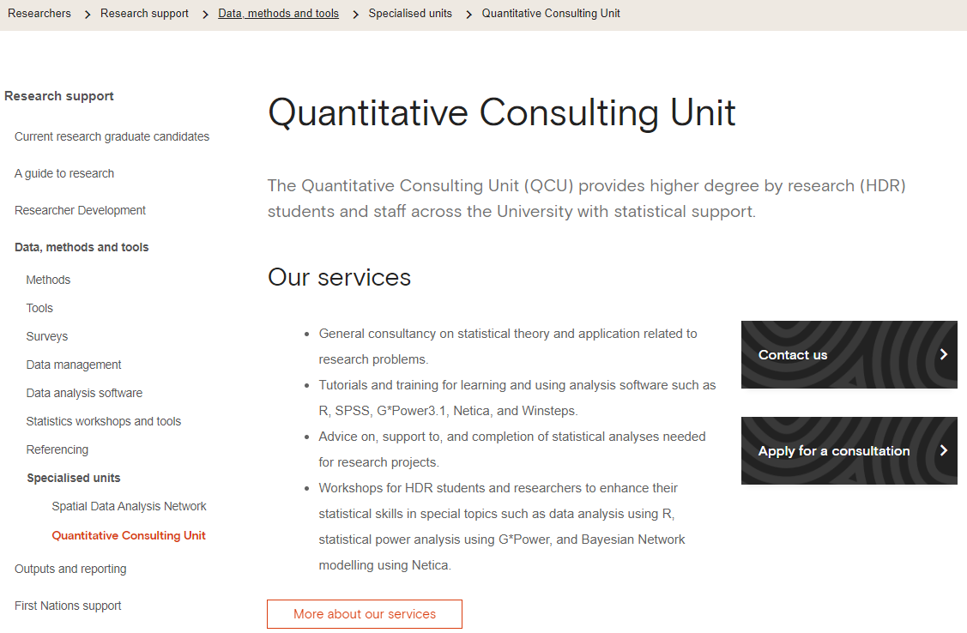
QCU’s website
6/11/2024 Copyright © Charles Sturt University 2020

Slide 7
Scientific research is a business of interplay between the qualitative and quantitative components
A Big Picture About DATA ANALYSIS
Quantitative
Analysis
Qualitative
Analysis

Slide 8
Thank You
for your attention and
Welcome for Questions and Comments
John Xie contact details: Email: gxie@csu.edu.au
Phone: +61-2-69332229
6/11/2024 Copyright © Charles Sturt University 2020

