Slide 1
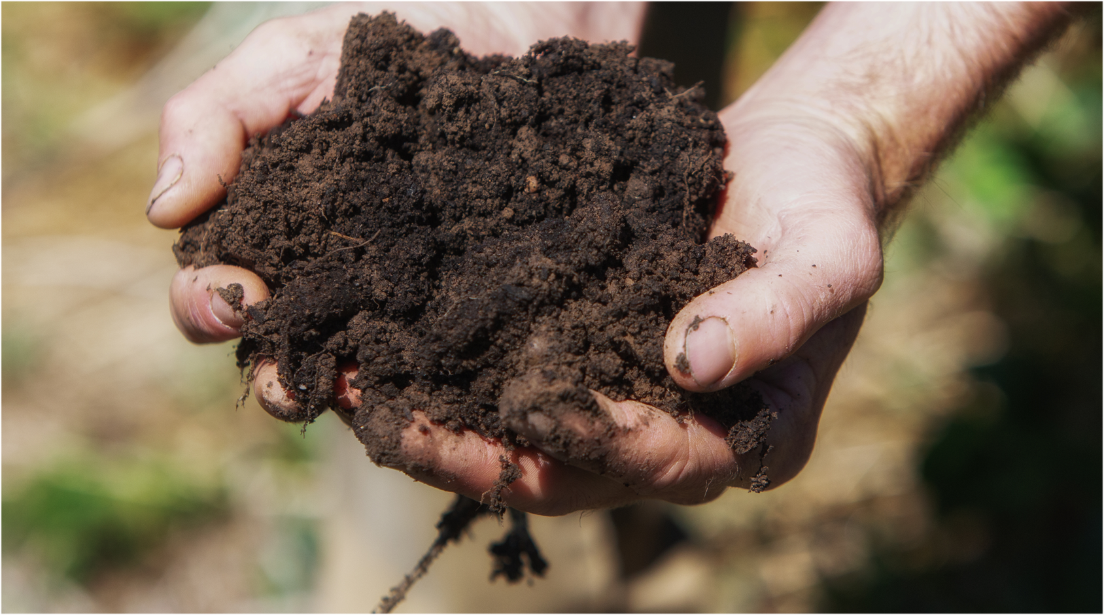
Section Two
Get your hands dirty
Notes:
Og designed slide

Slide 2

What is healthy soil?
Watch Matt Evans describe the abundance of life in our soils
How does he define healthy soil?
Notes:
Notes:
https://youtu.be/Q-Vb7c5dj_g link to video

Slide 3
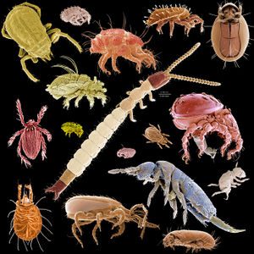
Life in our soils: microarthropods
Mircoarthropods help make microbes and fungi available to plant roots as food.
Soil microarthropods: Image credit (https://soil.evs.buffalo.edu/index.php/Microarthropods)

Slide 4
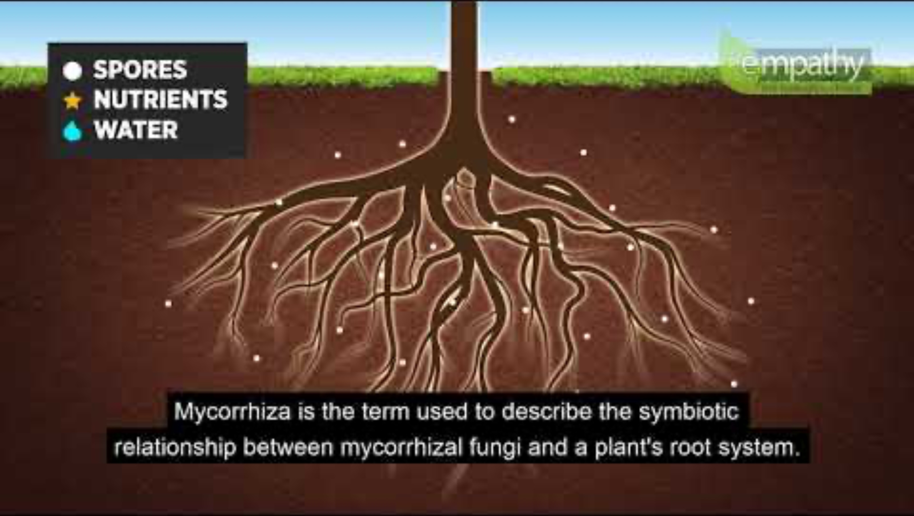
Life in our soils: fungi
Watch this Youtube animation of the symbiotic relationship between fungi and plant roots
Notes:
Notes:
https://youtu.be/v88gbtKBTv4

Slide 5
What is healthy soil?

Slide 6
Class discussion: Defining healthy soil
There is no single definition of healthy soil. Using what you have learned, what are some of the key things that are important for healthy soil that can grow our food?
From a human perspective, why are healthy soils important?
What sorts of life forms exist in our soils?
What are some of the key features of healthy soil (e.g., abundant micro-organisms and fungi, water holding capacity, organic matter and carbon, good texture)?

