Slide 1
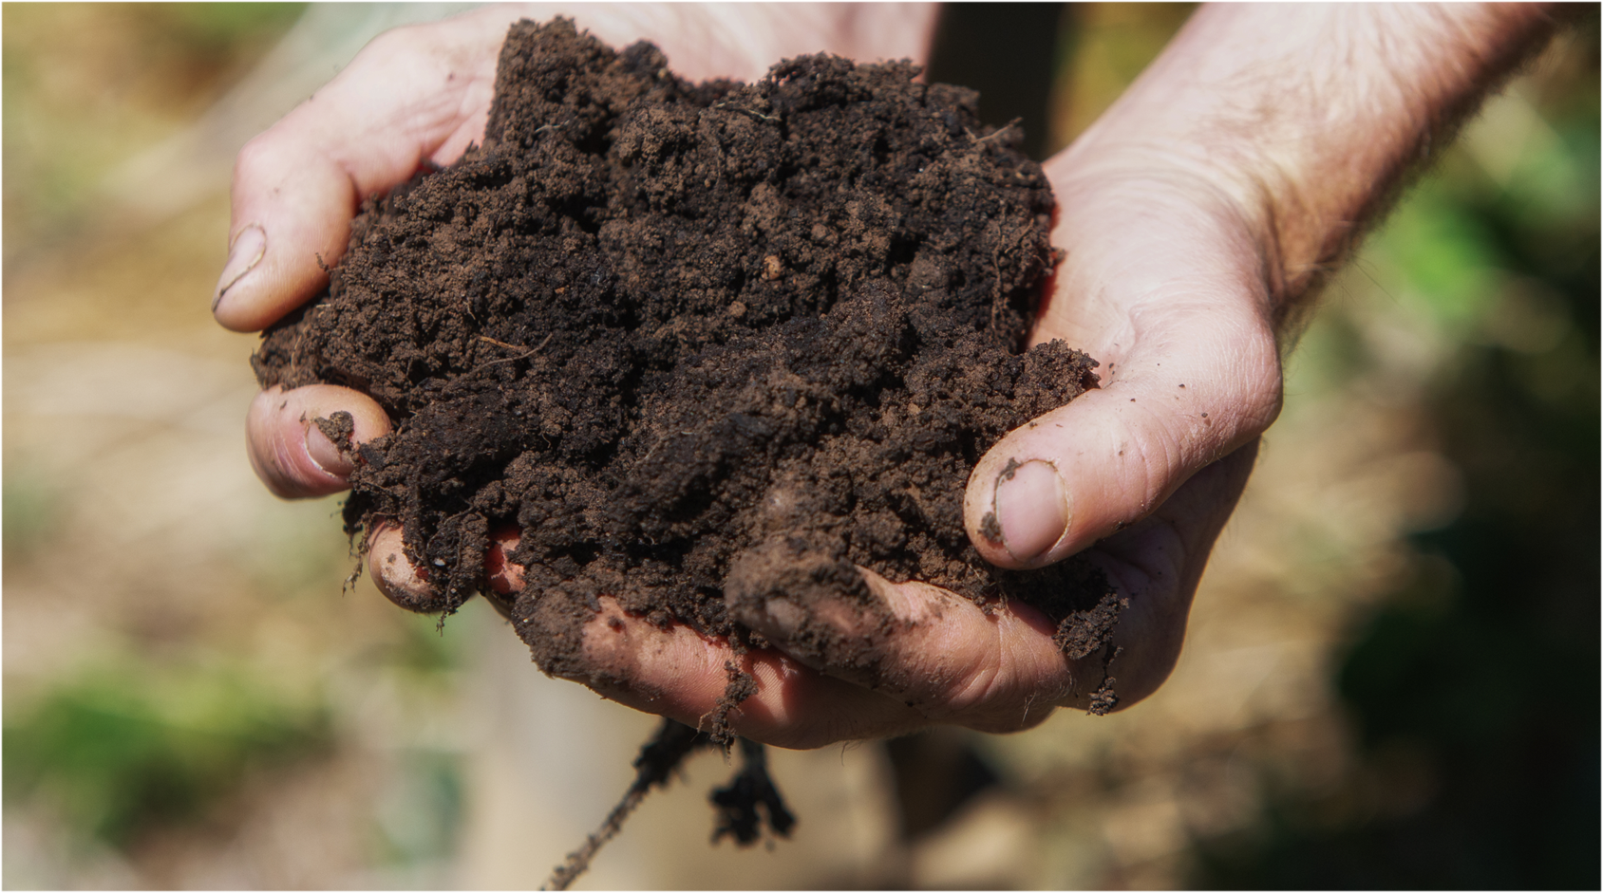
Section Six
What can we (consumers) do?
Notes:
Og designed slide

Slide 2
Consumer driven supply chains
Consumers have demands when they are shopping
Businesses (retailers and manufacturers) pass these demands on to farmers
Farmers must meet these demands to sell their produce

Slide 3
Bananas, bananas, bananas?
Consumers have preferences for bananas that are not ‘too small’ or ‘too big’
Supermarkets pass these on to farmers by setting size requirements on bananas that they will accept from farmers
Watch Craig Reucassel help measure bananas on an Australian farm – what happens to the bananas that are the ‘wrong’ size’?
https://www.abc.net.au/education/digibooks/war-on-waste/101750652?vcOpensOnLoad=true&vcPageId=103009168

Slide 4
Consumer demand for production practices
Regeneratively farmed food (e.g., pasture-raised meats, cover-cropped grains).
Brands with soil carbon projects (e.g., carbon farming initiatives like ‘cool farms’).
Reducing food waste – Less waste = less pressure on soil to overproduce .
Organic produce (grown without any artificial pesticides and fertilisers).
Free-range chicken and eggs (hens are not kept in overcrowded, small cages).
Here are some examples of consumer demand for production practices
Can you think of other examples of consumer demand for production practices?

Slide 5
Class activity- Debate
Should financial organisations fund and invest in farmers’ projects that support sustainable soils practices?
To prepare for your debate, read about Corporate Social Responsibility
Consider the following:
What roles do organisations like superannuation and investment funds have in supporting soil health?
Are the products made by farmers who invest in soil health measures worth more money? Why?

Slide 6
Class discussion
What role can consumers play in restoring our soils?

Slide 7
Class activity
RESEARCH: find out which supermarkets in Australia (if any) are selling products that claim to be focus on supporting soil health.
Make a note of
How many products the retailers claim they have for sale and the type of products that make these kinds of claims.
Write a letter to a brand or retailer who is not currently selling products made with soil health techniques, asking them to support farmers to maintain and improve soil health.
Your letter should explain
Why you think this important
What it is that you want them to do

Slide 8
How can we get consumers to care about soil?
Reason to pay: Watch video
Consumers: Watch video
Rhonda: Watch Video

Slide 9
Class discussion
What are the main messages?
What are they trying to persuade shoppers to think about?
Which (if any) of the messages do you find persuasive yourself?
What would you change to make it more persuasive?

Slide 10
What did the research find?
Charles Sturt University asked real consumers about these TVCs using qualitative and quantitative research methods
Qualitative research
involves asking groups of people questions (for example in focus groups or interviews) about their feelings, beliefs, and perspectives on the research topic.
is useful because people can tell researchers about their beliefs or experiences in their own words.
Focus groups participants were asked what they thought of the TVCs and why they liked or did not like them.
Quantitative research
Involves collecting and analysing numerical data (for example through surveys)
Is useful for determining how many people hold a view, or how strongly they hold that view
Survey participants were asked about their shopping preferences
They were also shown a TVC and asked how strongly they agreed that they would like to buy the product after seeing the TVC.

Slide 11
Qualitative findings
The Soils TVC was “boring” and had “too much information”
Some people liked the messaging linking soil and health, others thought it was boring
Rhonda was liked by some, but others thought it was “too emotive”
The Environment TVC was liked by most people. Some people liked the messaging about climate change but others disliked this.
The Reason to Pay TVC was liked by most participants.
The Multiple TVC seen as giving a good summary of why people should care about soil, but some people thought it was boring

Slide 12
Quantitative findings
A survey of Australian consumers asked about shopping preferences.
The survey identified 5 consumer segments. A segment is a group of consumers who have a shared set of preferences and concerns.
 | Aussie-first, Marketing Sceptics | Uninterested Battlers | Younger, Pragmatic Jugglers | Natural and Sustainable Shoppers | High-end Health Conscious
Summary Preferences | Australian made, support Aussie farmers, easy and tasty | Cheap, tasty and easy to prepare | Slight preference for easy to prepare, Australian made, cheap, fine food, unprocessed, environmentally friendly packaging | Australian made, support Aussie farmers, natural ingredients, nutrient rich and healthy food, unprocessed, env friendly packaging | Organics, healthy, natural ingredients, nutrient rich food, no processing, environmentally friendly packaging, fine food

Slide 13
Quantitative findings
Each segment has different socio-demographic characteristics
 | Aussie-first, Marketing Sceptics | Uninterested Battlers | Younger, Pragmatic Jugglers | Natural and Sustainable Shoppers | High-end Health Conscious
Summary socio-demographics and food expenditure | Older, mid income, more likely to be female, lower education, fewer children | Mid aged, average income, low weekly food spend, more likely to be female | Youngest cohort, lower income, more likely to be male, larger family size | Older, mid income, mid education, more likely to be female, fewer children | Mid aged, highest income and education, largest family size with segment 3, largest expenditure on food

Slide 14
Quantitative findings
How did different segments respond to the TVCs?
 | Aussie-first, Marketing Sceptics | Uninterested Battlers | Younger, Pragmatic Jugglers | Natural and Sustainable Shoppers | High-end Health Conscious
Trial ("The commercial told me about a new brand and I think I'd like to try it = strongly agree only)
Reason | 8% | 7% | 14% | 16% | 13%
Soils | 8% | 9% | 7% | 18% | 31%
Consumers | 7% | 11% | 12% | 21% | 27%
Environment | 16% | 8% | 8% | 21% | 17%
Rhonda | 20% | 9% | 23% | 15% | 21%
Costa | 8% | 13% | 8% | 22% | 24%
Multiple | 10% | 7% | 22% | 22% | 29%

Slide 15
Class discussion
Which TVCs appealed to the Natural and Sustainable shoppers?
Which segments did the Rhonda TVC appeal to?
Which segments did the environment TVC appeal to?
Which segment had the most positive response to the TVCs?
Which segment had the least positive response to the TVCs?
If you were to make a marketing campaign for Nurtured Lands, which segments would you target?
What are the demographic characteristics of these segments (socio demographic profile)?
What are they looking for when they go shopping (product preferences)?
How would you go about advertising to these segments?
What messages would you use?

Slide 16
Major assessment
Make a persuasive piece of communication to convince a group of consumers of the importance of choosing products produced using soil stewardship practices. You should include factual information about:
some aspect of agricultural soils such as the causes of degradation and loss of productivity
some of the practices that farmers are using to improve their soil
Remember the lessons from the CSU research – just telling people about soil is not enough.
How would you get them to care enough to buy a product or pay more for a product? What messages would you use? How would you make soil relevant to them?

Slide 17
Options
Communication format options:
Storyboard/script
Film/Tiktok/Instagram reel
Poster/infographic/website
Podcast

