Slide 1
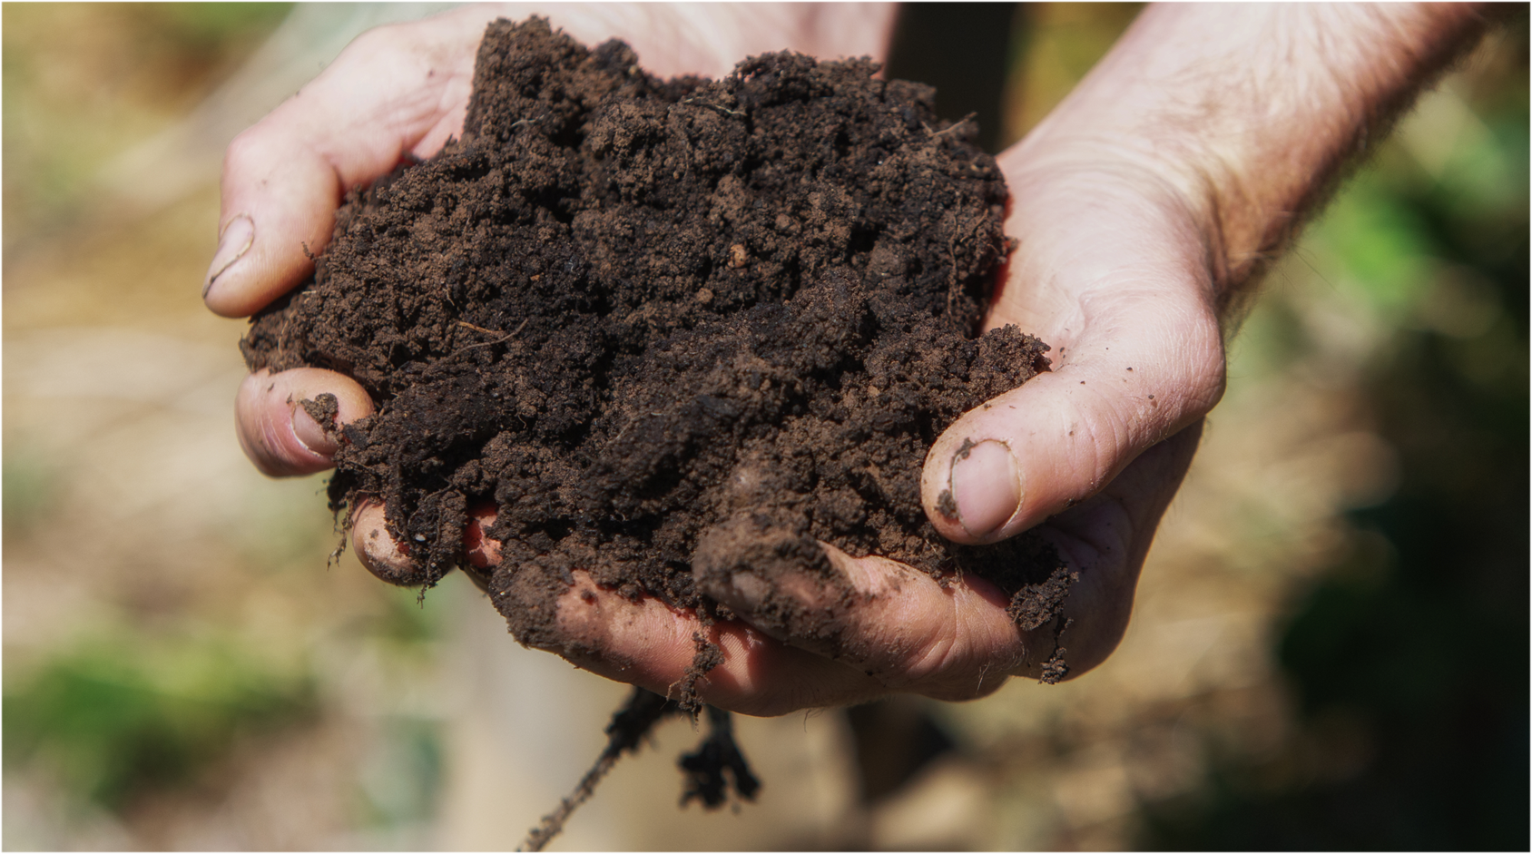
Section Four
Food security and why soil matters
Notes:
Og designed slide

Slide 2
What is food security?
Food security is defined by the United Nations Committee on World Food Security as the physical, social and economic access to sufficient, safe and nutritious food that meets dietary needs and food preferences for an active and healthy life.
Food security is often described as having four “pillars”
Availability refers to the supply of food, including the diversity and quality of food. Farming systems are essential for food security and must be sustainable and productive.
Accessibility refers to people’s physical and economic access to food and includes whether food is affordable
Utilisation refers to how people make use of various nutrients in food
Stability refers to the idea that issues such as war or drought may impact on food security

Slide 3
What is food insecurity?
The FAO defines food insecurity as not having “regular access to enough safe and nutritious food for normal growth and development and an active and healthy life“ (https://www.fao.org/hunger/en/).
Food insecurity can range from mild (some uncertainty about the ability to obtain food) to severe (not having access to food for more than a day).
Moderate food insecurity ranges from compromising on food quality and variety to reducing food quantity and occasionally skipping meals.
The United Nations Sustainable Development Goals include a focus on food security. SDG2 aims to:
  “End hunger, achieve food security and improved nutrition, and promote sustainable agriculture”, and ensure “ “access by all people…to safe, nutritious and sufficient food all year round” by 2030 (https://sdgs.un.org/goals/goal2).

Slide 4
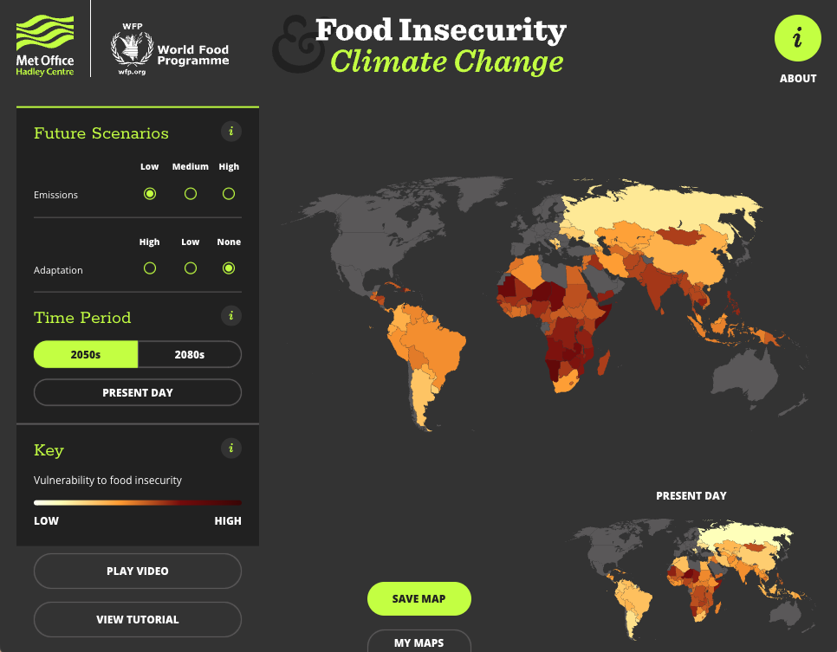
Food insecurity around the world
Food insecurity is expected to increase due to climate change and the increasing world population.
This interactive map is a useful demonstration of the impact of climate change on food security
The United Nations Sustainable Development Goals include a focus on food security. SDG2 aims to:
  “End hunger, achieve food security and improved nutrition, and promote sustainable agriculture”, and ensure “ “access by all people…to safe, nutritious and sufficient food all year round” by 2030 (https://sdgs.un.org/goals/goal2).
The FAO uses the prevalence of people who have moderate or severe food insecurity to help assess the worlds’ progress towards the UN Sustainability Goals (SDG2). Worldwide, 11.7% of people experienced severe food insecurity in 2021.

Slide 5
Food insecurity in Australia
Australia is one of the most food secure countries in the world.
In 2020, Australia was ranked 10th in the world for food availability, and 7th for food affordability.
The rate of severe food insecurity in Australia in 2020 was 3.6%
Food insecurity has increased due to rising cost of living (including food). In 2023, 31% of Australians experienced moderate food insecurity.

Slide 6
Soil and food security
Agriculture is essential for the availability pillar of food security. Without a productive agricultural system, the ability to produce sufficient food is reduced, leading to food insecurity.
Soil degradation is a key threat to sustainable food security because it reduces the capacity of the land to produce quality, nutritious food.
Because of the importance of soil for food security, improving soil health is part of the UNSDG2 to end world hunger and food insecurity by 2030. Target 2.4 is:
  “By 2030, ensure sustainable food production systems and implement resilient agricultural practices that increase productivity and production, that help maintain ecosystems, that strengthen capacity for adaptation to climate change, extreme weather, drought, flooding and other disasters and that progressively improve land and soil quality”.

Slide 7
Factors leading to soil degradation and food insecurity
Agricultural practices
tillage
land-clearing
over-use of fertiliser
over-grazing
Climate factors
drought
flooding
Desertification and climate change are major threats to food security.

Slide 8
Soil and food insecurity mind map
Add at least one item from each column to the mind map below. Draw arrows to indicate the relationship between them, and how they increase food insecurity.
Agricultural practices
Over-use of Nitrogen fertiliser Land-clearing Over-grazing Intensive Tillage
Reduced food production capacity of soil
Soil health
Soil acidification Poor water penetration Erosion Reduced soil fertility
Climate and weather
Climate change Flooding Drought Desertification

