Slide 1
Welcome CS Peer Reviewee
Today:
Overview of peer review @ CS.
Peer review supporting documents.
Suggested approach – evidence

Slide 2
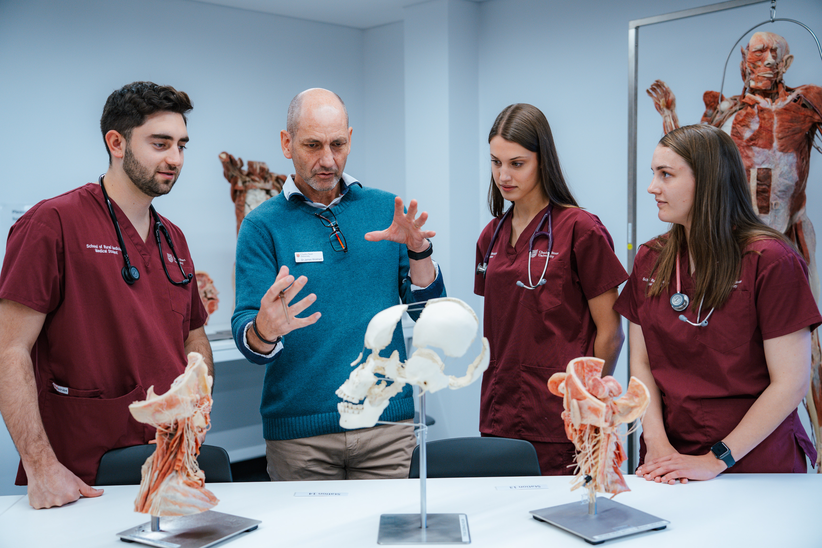
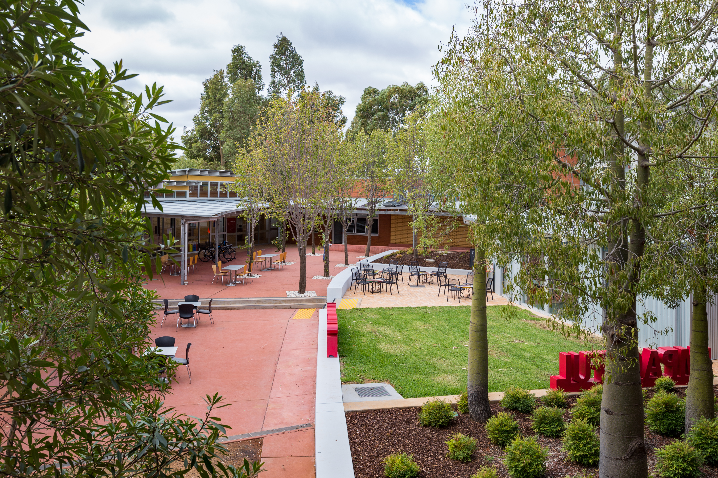
Acknowledgement of Country
The Division of Learning and Teaching acknowledges the transformative effect of education. Our impact leads to ever improving educational outcomes, inspiring our students to create a world worth living in.
We recognise the inclusive nature of First Nations educational practices and the innovative strategies that have ensured the continuing diversity of lands, waters, and peoples for millennia. We also acknowledge that in our practice we are guided by the Elders, past and present, of the Country in which our campuses live – Wiradyuri, Biripai, Gundangarra and Ngunnawal.
In the spirit of Yindyamarra Winhanganha, we recognise the depth of First Nations Ways of Being, Ways of Knowing and Ways of Doing, inspiring our commitment in supporting staff and students in ‘the wisdom of respectfully knowing how to live well in a world worth living in’.

Slide 3
Peer review @ CS aims to:
Support the demonstration of excellence –reviewees identify areas of teaching practice to showcase and provide a range of evidence to support and substantiate their claims.
Enable learning and improvement –staff reflect on their educational practice with a view of understanding it better and developing it further.
Foster collegiality and relationships –peers engage in collegial and supportive interactions and discussions.

Slide 4
Types of peer reviews
At CS reviewees can request a summative or formative peer review to:
Support their application for promotion (summative).
Meet their probation conditions (summative).
Support their development as teachers (formative).
2023 figures: @ 74 peer reviews
Promotion 45: Probation 16: Formative 13

Slide 5
Peer review dates
Promotion
Last day for requests for Peer Review to be received by DLT - 30 April 2024.
Week commencing 6 May Peer Review team notifies of allocation peer reviewer/reviewee.
May to July reviewee and reviewer liaise to complete peer review.
Last day DLT accepts completed peer reviews for promotion from peer reviewers - 26 July 2024.

Slide 6
Peer review dates
Peer review for probation within 6 months of probation.
Formative peer reviews no formal time frames. Can request anytime.
For peer review for promotion: Reviewers cannot do a peer review for promotion in the same year they are going for promotion.

Slide 7
Peer review of teaching practice
A peer review provides evidence of teaching practice.
Teaching practice includes all practices that impact the student learning experience at Charles Sturt, such as:
Direct teaching (includes learning design and assessment).
Higher Degree by Research supervision.
Work Integrated Learning supervision.
Educational leadership.

Slide 8
Peer reviewers
An objective and trained peer reviewer is allocated to conduct a peer review. CS peer reviewers must:
Have at least three years of experience in Higher Education teaching.
Be available for approximately 1.5 - 2 hours for each review (maximum of 2 reviews will be allocated).
Be able to complete the peer review report in a timely manner (26 July 2024 for peer reviews to support promotion).

Slide 9
Peer reviewers
To ensure fairness and impartiality CS Peer reviewers are:
Assigned to a peer reviewee by the peer review team.
At least one level higher than the person seeking the review, wherever possible.
From outside the school and, if possible, the faculty of the person seeking the review.
An alternate peer reviewer can be assigned if there is a conflict of interest or other issue.

Slide 10
Peer review overview
Peer reviewee requests a peer review.
Peer review team assigns the peer reviewer.
Peer review team emails the peer reviewee and copies in the peer reviewer as an introduction.
Peer reviewee arranges initial meeting with reviewer to discuss and plan peer review.
Reviewee and Reviewer liaise to complete peer review.
Peer reviewer prepares and submits the final report to peer review team.

Slide 11
Peer review process
Reviewee - deep reflection, construct narrative and provides supporting evidence - @ 5 hours.
Reviewer - evaluate the reviewee’s evidence and narrative around their teaching practice and prepares constructive and accurate comments - @ 1.5 hours.
An initial meeting between reviewer and reviewee (30 mins)- discuss the context and identify the four teaching capabilities to be reviewed
Reviewee reflection, evidence gathering, and link to template (up to 5 hrs)
Reviewer appraisal of reflection and evidence and prepares constructive and accurate comments (1 hr).

Slide 12
Peer review supporting documents
Single template aligned with Teaching Capabilities Framework and Self-assessment Tool (TCF-SAT).
Supported by Guidance Note to support reviewees and reviewers to understand how teaching practice can be evidenced.
Guidance on types of evidence to support claims

Slide 13
Teaching capabilities
Reviewee chooses four capabilities from the TCF-SAT
considering their:
Context
Claim
Evidence
Reviewer critically evaluates the evidence and makes constructive and accurate comments.

Slide 14
Approach to evidence
The peer review is one component of evidence – make it count:
Give the reviewer evidence of your best practices
Ensure your evidence aligns with your claims
Provide a mix of evidence to support your claims
Peer reviewer comments on what they see (snapshot)

Slide 15
Contact
Deborah Scheele
Peer Review Team
PeerReview@csu.edu.au

