Slide 1
Rural and remote health and technology
Linda Shields MD (Research), PhD, FACN, FAAN
Professor of Rural Health
Faculty of Science
Charles Sturt University
Bathurst, NSW
and
Honorary Professor, School of Medicine,
The University of Queensland
Brisbane
Australia
Notes:
This is an alternative title page with space for images.

Slide 2
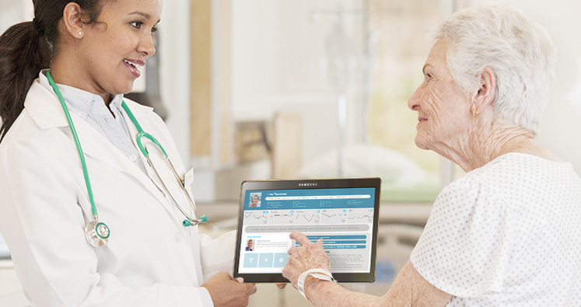
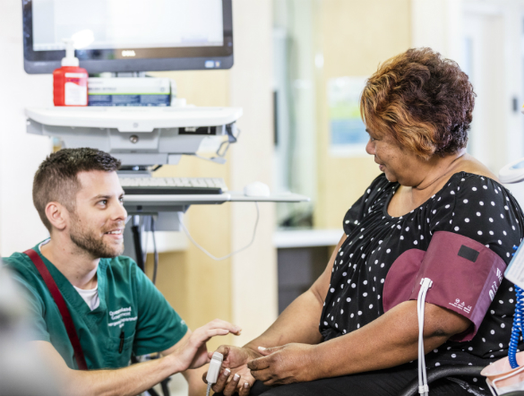
Electronic Integrated Medical
Record (eIMR)

Slide 3
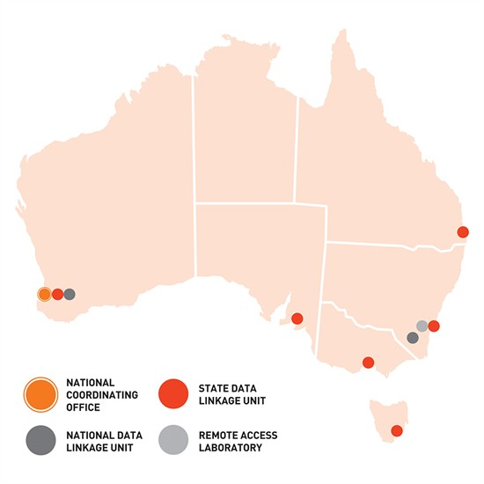
Data linkage

Slide 4
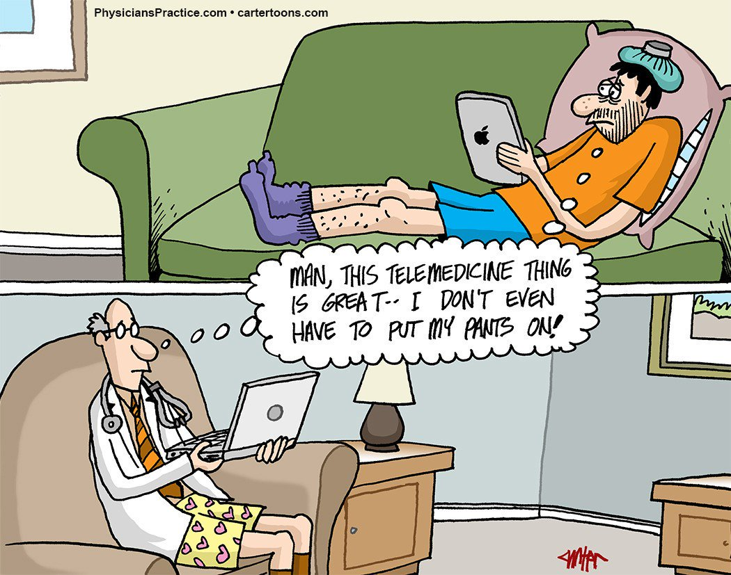
Telehealth /
Telemedicine

Slide 5
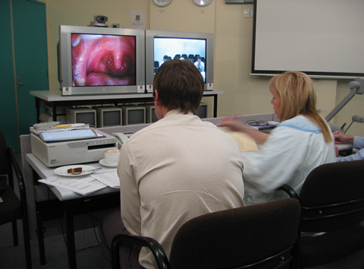
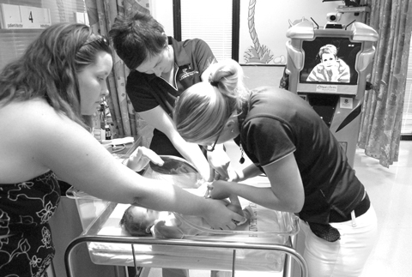
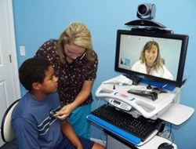

Slide 6
